Slide 1
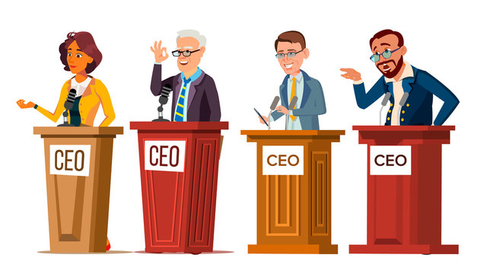
Effective Communication
It’s a soft skill
A common skill found among successful people

Slide 2

What I have learned
What I have Implemented
What’s the benefits I have got

Slide 3
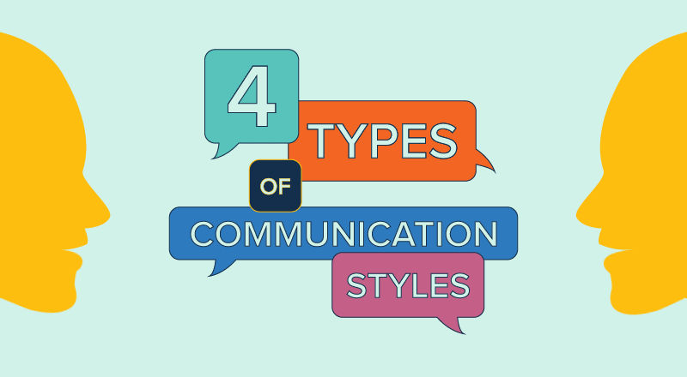

Slide 4
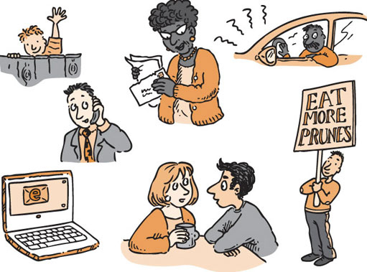
4 types of Communication
Non-verbal
Oral
Para-verbal
Written

Slide 5
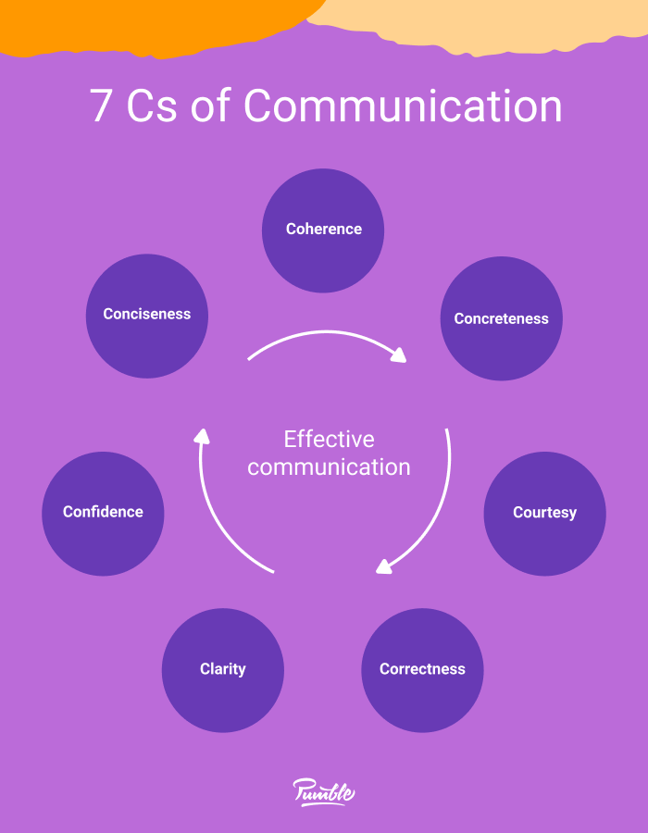
What I have learned
Types of Communication
(Written, Verbal, Non-verbal, Listening)
Body Language
7C’s of Effective Communication
Writing Technique of 4W
Email Etiquette
Phone Etiquette

Slide 6

What I have implemented
Clarification
7C’s of Effective Communication
4W of Writing technique
7 Golden rules of listening
Tone of Voice (Para-verbal)
Proxemics (Maintaining distance)
Self Assessment (Most Important)

Slide 7

Benefits I have got
Art of Listening
More attentive during lectures
Tone of Voice
Better understanding during conversation
Improvement in writing (Email )
Email became friendly to receiver
Having faster reply

Slide 8
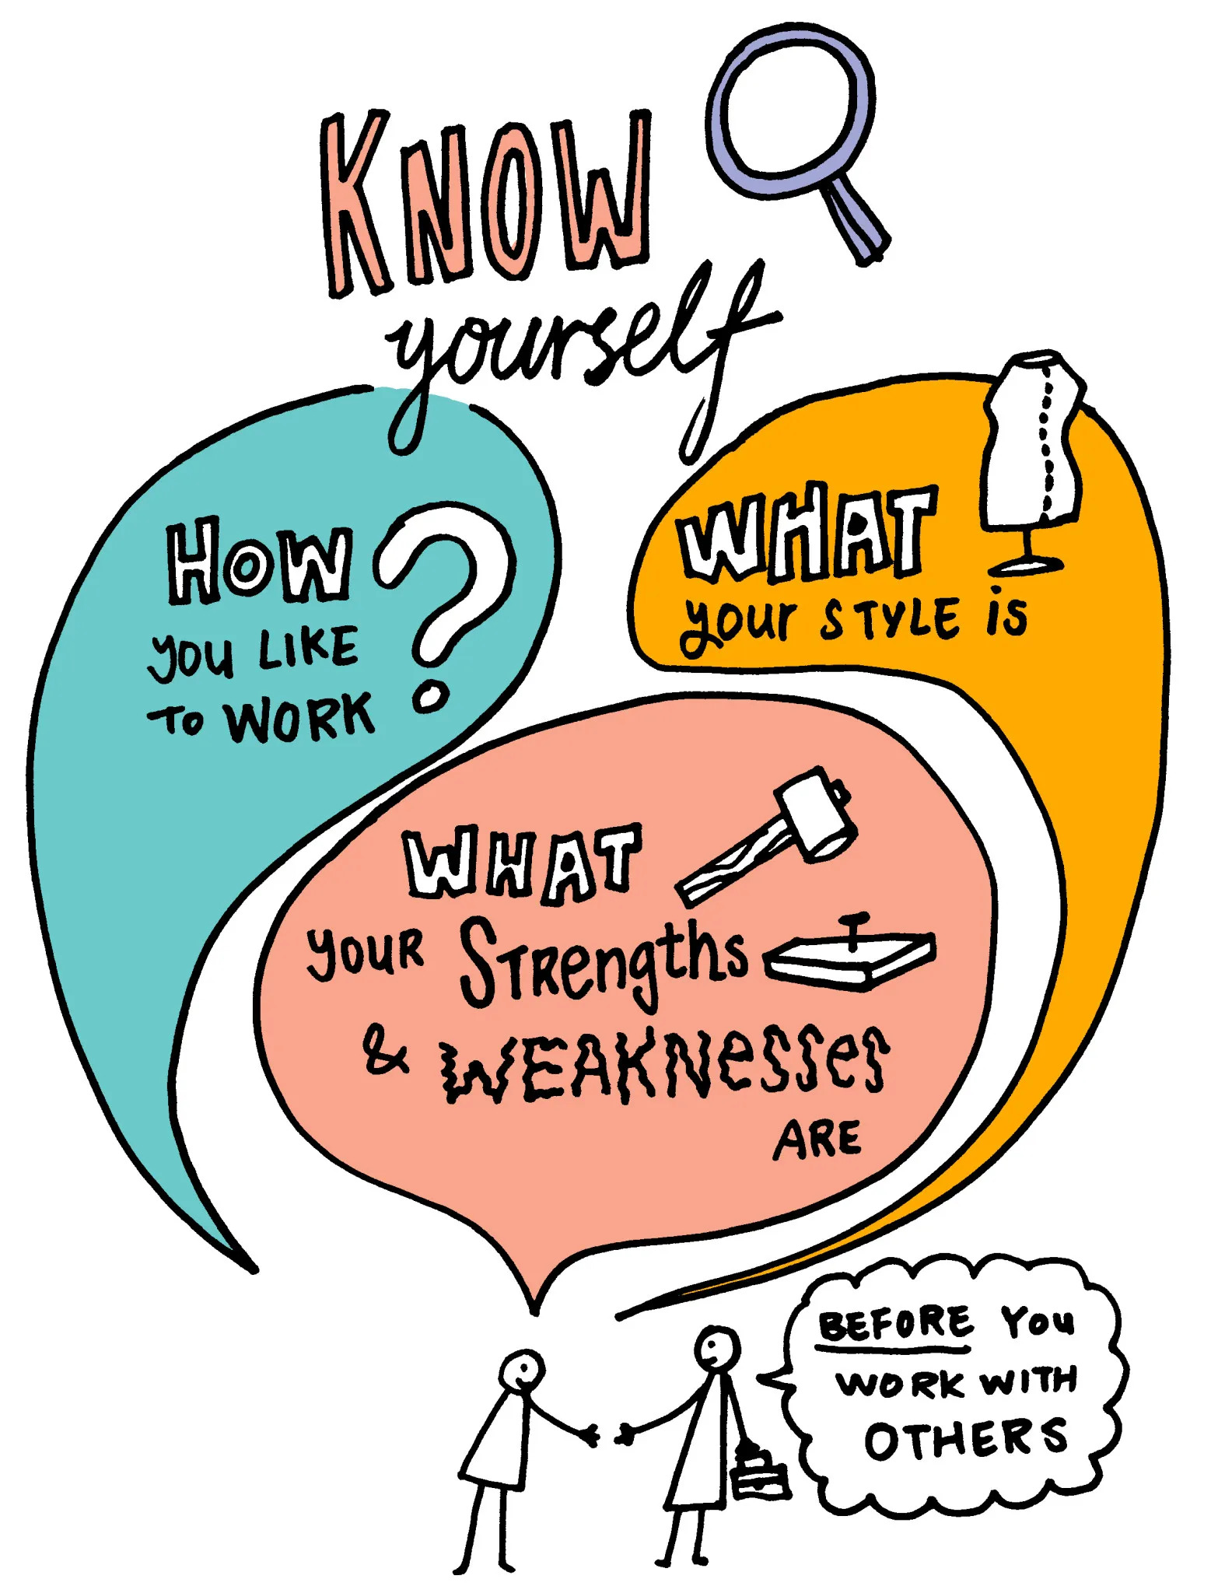
Benefits I have got
Better understanding
I know my lacking in communication using self assessment. So, I’m working on that specific issue and it’s improving day by day.

Slide 9
Special thanks to
Dil Nusrat Ma’am
Assistant Professor, UIU
Sheikh Shakib Hossain
ID: 011221031

